Slide 1
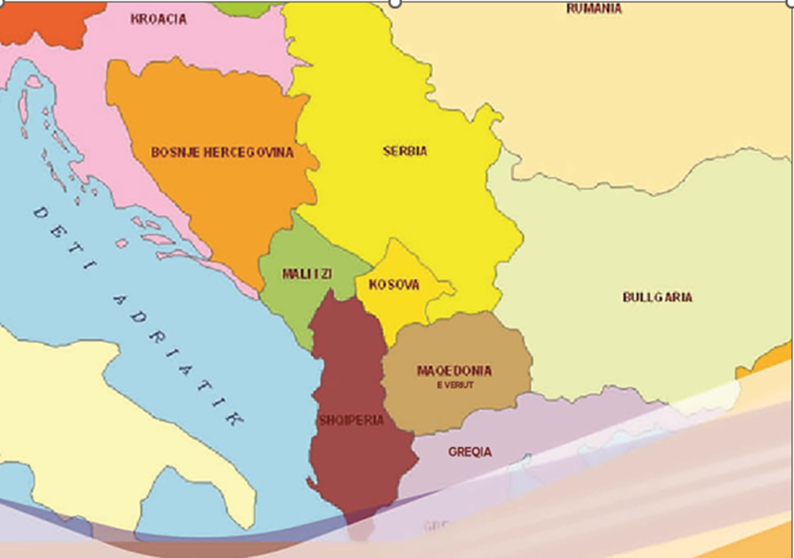
"INTERLANGUAGE IDIOM IN WRITTEN ALBANIAN DISCOURSE
AND OTHER INDO-EUROPEAN LANGUAGES"
Prof. dr. Ali Jashari
“Fan S. Noli” University, Korçë
PROF. DR. ALI JASHARI
“FAN S. NOLI” UNIVERSITY, KORÇË

Slide 2
A daily newspaper published an article entitled "Bermuda Triangle", a historical development of Albanian politics” and then in other newspapers this became the expression of the day, being used in different contexts such as: including it in Bermuda Triangle, compared it to the triangle of Bermuda; had brought to mind the famous Bermuda Triangle, etc.
These expressions in today's linguistics are named by different terms, such as borrowings, calques, borrowed idioms, etc., they are commonly used in written discourse, more often in journalism, literature, history, philosophy, sociology, by occupying a special layer in the idiomatic of any language; they are recorded and explained in bilingual explanatory dictionaries, even some special dictionaries have been written for them.
In this lecture, in front of the terms we mentioned above, we prefer to use the phrase "interlanguage idiom" (hereinafter Ind), as we will explicate below.

Slide 3
The layer of interlanguage idioms in Albanian written discourse can be summarized in three large groups:
INd that are created independently in each language, but have approximately the same parts and are used with the same meaning in different languages. This happens due to the matching of thoughts brought by life experience, relation to customs, spiritual and cultural heritage, mutual economic exchanges, and historical events where many nations have had the same fate.
Usually, in such idioms, the meaning is a part of the human body: eyes, ears, lips, head, legs, ribs, nose, mouth, etc.
To argue this, we are bringing some examples with the meaning "eye":
hap sytë; it. aprire gli occhi; angl. open one’s eyes; rus. глаза разуть;
iu hapën sytë; frëngj. ouvrir l’oeil; rus. глаза открылиcь;
ia hapi sytë; it. aprire gli occhi (a qualcuno); angl. open smb’s eyes;
sa i ha (i rrok) syri; angl. as far as the eye could reach; ital. a perdita d’occhio; frëngj. à perte de vue;
gjithë (tërë) sy e veshë; angl. all eyes and ears; ital. essere tutt’occhi e tutt’orecchi; frëngj. tout yeux tout oreilles;
sy për sy e dhëmb për dhëmb; it. occhio per occhio e dente per dente; angl. eye for an eye and a tooth for a tooth.

Slide 4
2. INd from other languages have entered the Albanian language in the translated form, usually mot á mot and constitute the largest number of INd.
The sources of these INd groups are many:
of biblical origin, such as: alpha and omega; Abraham's anxiety; The Second Coming; the new patch on the old garment; it was sold for thirty pieces of silver; prodigal son; daily bread; Render unto Caesar the things which are Caesar's, and unto God the things that are God’s; …
derived from mythology, such as: clean the stables (stables) of Auggia; Ariadne's thread; the stone of Sisyphus; the Trojan horse; Pandora's box; Apple of Discord; Gordian knot; sword of Damocles; Achilles' heel; the barber of Midas; cross the Acheron; the golden horde; the flight of Icarus;…
sourced from history, geography, etc., as: Even you, Brutus?; discovered America; pyrrhic victory; Columbus's egg; Hannibal's oath; keep your gunpowder dry; Spartan education; the golden age; …
sourced from literature, folklore, etc., such as: storm in a teacup; fight windmills; much ado about nothing; A Farewell to Arms! The Fox and the Grapes; word word word; the shadow of Banquo; scowl-faced horseman; nurse the snake in her bosom; …

Slide 5
sourced from philosophy, politics, etc., such as: Buridan's donkey; sufficient reason; I know that I know nothing; Achilles can never overtake the tortoise; platonic love; I think, therefore I am; socratic irony; the end justifies the means; a place under the sun etc…
sourced from other fields, such as: communication vessels; common denominator; minefield; blue helmets; pharmacy scales (balance); shameplant mimosa; ostrich policy; center of gravity (of weight); transmission belt; black hole; multiply by zero; put the equal sign; conductor's baton; first violin etc…
a good part of INd have a purely linguistic character and have been translated from the original languages, such as: fait accompli; fixed ideas; white card; local color; dot the "i"; read between the lines; vicious circle; burst the door open; cast shadows etc. …

Slide 6
INds that are not translated in Albanian language and other languages, i.e. they preserve the same phonetic composition as the original languages.
from Latin (which make up most of this group), as: ab incunabulis; ad augusta per augusta; ad hoc; ad usum Delphini; advocatus diaboli; alter ego; alma mater; aperto libro; ars longa,vita brevis; …
from the French, as: a la carte; a l’eau de rose; a livre ouver; amour proper; après nous le deluge; a propos des bottes; …
from English, as: big bang; big brother; ever say never; fair play; fifty-fifty; five o’clock; happy end; knock-doën; mealting pot; much ado about nothing;…
from German, as: Aussprechen was ist; befehl ist befehl; Blitz Krieg; Blut und Eisen (Eisen und Blut); Grosen un Ganzen; Mehr Licht; Naht und Nebel; Shturm und Drang etj.
from Italian, as: colpo di stato; cuopri fuoco; dolce far niente; dulce in fundo; eppur si move; guarda i passa; pezzo grosso; salto mortale etc...
from Greek, as: dhakrojen jelasomen; Eureka! gnoti seauton; kai sy teknon etc…
In many cases INd of the second and third groups are used side by side, especially in translated works, such as: test balloon (balon d'essaie); in the Greek calendars (ad calendas graecas);…

Slide 7
The most well-known authors that write or translate in the fields of literature, are engage also in creative language work in two directions: they create new units and stylistically process the tools that are part of the language.
Literary the inter-language idioms are also processed in terms of construction and understanding, in order to fit the type of writing or problem being addressed.
What are the innovations observed in the use of INd in the written Albanian discourse?
“Deformation” of the Inter language Idioms structure
In this way, the stuttered form, as the full form, preserves the lexical meaning and emotive notion. For example fjalët i merr era, e shkruara mbetet from Latin verba volant, scripta manent appears in this form fjalët i merr era (verba volant), by meaning “words are worthless if they are not accompanied by actions; words are quickly forgotten”. But the second part is also used e shkruara mbetet (scripta manent).
Many intercultural idioms are not used with a single lexical composition, but they vary by having elements such as words that are similar in meaning.
This shows the phenomenon of lexical variation (lexical variability). This is related to the synonymous possibilities that Albanian language has to calculate the consistent expressions from other languages.

Slide 8
Lexical variability is a novelty and, at the same time, an important feature of the use of INd-s in the Albanian language, for example: ahuret (stallat) e Avgjisë) (stables of Avgji); çaj (thyej)akullin (break the ice); biri(djali) plangprishës (prodigal son); filli (peri) i Arianës, shpërthen (thyen) një derë të hapur (the Ariana’s thread destroys an open door); ...
The intercultural idioms appear in multiple lexico-syntactic connections, in narrow micro-contexts or in different sentences. Even in this aspect, we have novelties with special values related to the use of INd in discourse.
The study of these lexical-syntactic connections or the semantic-syntactic field of INd is not just a matter of form, because their meaning and stylistic-emotional values are better revealed in relation to other words in speech.
e bën-
e cilëson-
është-
e përdor-
e quan-
e fut-
hyn si-
luan rolin e -
shpreson me anën e-
e pranon si-
mbetet si-
ka si-
KALI I TROJËS (SI KALIN E TROJËS; KALË TROJE)

Slide 9
As observed, only this INd in Albanian consists of 13 words of the lexical circle, depending on which the forms of use also change.
The circle of connections can be expanded or narrow depending on the lexical meaning and the values that INd carries, such as:
lë-
bëj-
realizoj-
prodhoj-
shtyj-
NË KALENDAT GREKE (PËR NË KALENDAT GREKE)
There are also many INd-s with extensive lexical and syntactic connections, such as: kolonë e pestë (fifth column) “armik i fshehtë” (“hidden enemy”); people who secretly develop activities against someone or something else"; rreth vicioz (vicious circle) “impasse; difficult position"; shkopi i dirigjentit (conductor's baton) "means or way to convince or subjugate someone or something" etc. …

Slide 10
Another phenomenon is the actualization of INd, that is, the introduction of other words into their structure to connect them more closely with the concrete situation of the discourse, events, characters or the issue that is being written about, with the time or the place that is being discussed in the given context.
In other words, through the actualization, the aim is to establish close connections between the meaning of INd and the specific situation of the written discourse.
The actualization can occur in all positions of the elements so actualizers are placed before, in the middle, and after the INd elements, for example:
akulli i heshtjes u thye (the ice of silence broke); u thye akulli diplomatik (diplomatic ice broke); kolona e pestë shqiptare (the fifth Albanian column)
turbullon ujërat e kulluara (blur the strained water etc.; mund të peshkojë mirë e rehat në ujë të turbullt (can fish well and comfortably in troubled waters); …janë mësuar të peshkojnë në ujëra të turbullta të dallaveres e të kompromisit (...are used to fishing in the turbid waters of deceit and compromise);

Slide 11
The contamination of INd-s is also a well-developed phenomenon that involves innovations in their usage in written discourse.
Under this term it is perceived any kind of fusion, intermingling or mutual exchange of constituents of two or more INd, usually with similar meanings or with common constituents which is done for reasons of the deformation of the phrase or other stylistic purposes
humbasin çdo logjikë kur shohin t’u digjen në duar kartat e fundit (they lose all logic when they see the last cards being burned in their hands (nga ia djeg kartat (letrat) në dorë dhe luaj kartën e fundit) burn the cards in my hand and play the last card)
ngritën peshë në këmbë gjithë Shqipërinë (lifted weight the whole Albania) (ku INd u ngrit peshë në këmbë “u mobilizua, u tregua i gatshëm” është rrjedhojë e kontaminimit të dy njësive (where the Interlanguage idiom stood up "was mobilized, showed itself ready" is the result of the contamination of the two units: u ngrit peshë dhe u ngrit në këmbë) (he lifted his weight and stood up etc..

Slide 12
In the written discourse, contexts where two INd are used side by side, in a double connection, are often encountered. The joint use and pairing of intercultural idioms is not fortuitous.
Double constructions with INd constitute a wide phenomenon, with certain semantic and stylistic functions within a segment of written discourse.
Precisely, the study of these relations is important to observe the ways in which this INd connections and the semantic phenomena that are embedded in them.
For example: this means inserting kolonën e pestë, kalin e Trojës (the fifth column, the Trojan horse), ka zënë kokën me dorë (he grabbed his head with his hand) and nuk di nga t’ia mbajë (can’t hold on) where intercultural idioms are synonyms.
In written discourse, pairing occurs even when INd has the opposite meaning, that is, they have an antonymic semantic connection.
For example, we don't seek to win our freedom tue shtri dorën (by extending our hand), but tue tregue grushtin (by showing your fist) ... the meaning differs when saying t’u fërkosh krahët atyre (it is different to rob their arms) and t’u tregosh grushtin (to show them the fist)…

Slide 13
The joint use and pairing of INd brings new semantic and stylistic values to the written discourse, makes the phrase more powerful and beautiful, conveys the idea or thought in a more simple and convincing way.
The features and values of such connections are observed both in the formal (structural) aspect, as well as in the semantic and functional aspect.
In most cases, the double connections of intercultural idioms add to the microcontext positive or negative evaluative notions, which are their own characteristics.
In fact, those intercultural idioms that have a strong emotive notion are usually connected in pairs, but the most important thing is that they are essentially synonymous or antonyms, or they might have complementary connections for a more general common or opposite semantics.

Slide 14
In the written discourse of the Albanian Language, with Ind are created also strings of such units which are lining up within a narrow context according to semantic and stylistic connections organized around an idea or characterization to complement each other from different sides.
This indicates that to create a string you cannot include any Ind but only those that have or will have certain meaningful and emotional relationships with others (usually synonymous, antonymic, mixed, etc.)
These units make the context more powerful and expressive, give the idea or thought more convincing, and the author's appraisal is clearly expressed.
ato që tha ai ishin fjalët e një të çorodituri (what he stated were the words of deranged person), e një të marri të hutuar (of a confused person).
që lëpin ç’ka pështyrë, që pështyn çka puthur (who licks what he spits, who spits what he kisses)
që lëshon lotë krokodili( who sheds crocodile tears).

Slide 15
In the written discourse, there are also changes in the categorical data of INd, verb to noun, adjective and adverb.
It turns into nouns more two-limbed INd-s and less those who have three or more limb.
All these structures form open types, which, especially in journalism language discourse, are constantly enriched, since, theoretically, but also practically, from all verbal INd, can be formed respective nominal INd, by the language needs :
NOUNS: ice melting; sharpening weapons; loss of compass; ground preparation; emphasis; take off the mask …
ADJECTIVES: put on a pedestal, fall out from the sky; provided with weapons, caught checkmate, fallen from the fig tree, lifted up…
ADVERB: behind closed doors; with a raised voice; with a broken heart; with the mouth shut; with a fist clenched etc.
In addition the usage of the INd monosyllabic structure like blickrig “luftë rrufe” from blitz krieg; blekaut nga black out; bonsens from bon sens; brainstorming from brain storming etc… it is an innovation in how they are processed and turn into monosyllabic, changing the "status" in the written discourse of Albanian.

Slide 16
Studying this linguistic reality, which we explained above, Ind cannot be seen as a “foreign body” in the Albanian language body, but as a part of it as a cultural language, as a sign of mutual relations in the cultures of different peoples and as a concrete expression of the cultural upliftment of the Albanian people.
Peoples, today and all the time, have benefited from each other's culture. On this basis, the entry and usage of INd is a phenomenon encountered in all developed countries.
This is a phenomenon that has been noticed for a long time in the Albanian language.
Whoever has read the translated literature and journalism of the 30s of the last century, without doubt, has noticed this.
INd are evidenced in the earliest monuments of the Albanian language (as in Buzuku: i jap lavd, merr formë, u bëftë dritë, etc.), but, especially in the last thirty years, that our country has opened up to the world, thanks also to our people thirst to learn other languages ​​and to know other cultures, thanks to the numerous translations from historical, philosophical, sociological, publicists literature, etc., in the Albanian language there is a flow of large INd units (so far we have registered over 9500 such units)

Slide 17
In conclusion, if we go back to the example we told at the beginning, where the expression "Bermuda triangle" within two or three weeks was inflexion in all cases by the newspapers of the day, we can say that journalism plays a first-hand role in using and embedding the INd in the written discourse, subsequently come the linguists who sort them in dictionaries, with explanations and similes, to keep them in the written language and to be passed down to generations.
The most important thing is to recognize them and use them correctly.
Nowadays an anecdote is told about the time when Dritero Agolli was a parliamentarian one of his colleagues from the opposition in his speech among other things stated: “our work is like Joseph's stone" but Dritëroi interrupted him saying "like the stone of Sisyphus and not like the stone of Joseph!". "But it's the same, said the colleague" and all the parliament erupted in laughter.

Slide 18
LITERATURE CITED
Agolli, D., Nulla dies sine linea, Tiranë, 2017, f. 5;
Ahmanova, O.S., Sllovar lingvistiçeskih terminov, Moskva,1966. f.137;
Babkin, A.M. Ruskaja frazeollogjia, jejo razvitie i istoçniki, Leningrad,1970, f.46;
Crystal, D. The Penguin dictionary of language, 1999;
Dubois J. Dictionnaire de linguistique, Paris, 1963, f. 164;
Ilyish B., The structure of Modern English, Leningrad, 1971, f.174;
Jashari, A. Frazeologjia në letërsinë politiko-shoqërore, Studime filologjike, 4/1990;
Kostallari, A., Kompozitat dëshirore dhe urdhërore të shqipes, në Studime mbi leksikun dhe formimin e fjalëve në gjuhën shqipe, I, 1973;
Kunin, A.V. Frazeollogija savremjenovo anglijskovo jazyka etj.
Matthews, P. H., Concise dictionary of linguistics, Oxford, 1997, f. 41, 45;
Meksi, M. Letërsi e ndaluar dhe shkrimet e fshehta, Tiranë, 2011, f. 205-206.
Thomai, J. Një fjalor që i mungonte kulturës shqiptare, Gjuha shqipe, 1/2008, Prishtinë, 2008

Slide 19
THANK YOU!

